Slide 1



Kivy - Buildozer
Hamilton Python Users Group
Ian Stewart
9 March 2020

Slide 2
Kivy - Buildozer
Objectives:
Create GUI applications using python3 on linux platform.
Deploy the applications to an Android mobile phone.
Solution:
Kivy - Python library for developing mobile apps.
Buildozer - Python packager for Android and iOS.

Slide 3
Kivy
Kivy is a free and open source Python library for developing mobile apps and other multitouch application software with a natural user interface (NUI).
Initial release: February 1, 2011.
Stable release: 1.11.1 - 21 June 2019.
Repository: https://github.com/kivy/kivy
Website: https://kivy.org/
Docs: https://kivy.readthedocs.io/en/latest/index.html

Slide 4
Buildozer
Buildozer is a tool that aims to package mobile phone applications easily. It automates the entire build process, downloading the prerequisites like python-for-android, Android SDK, NDK, etc.
Buildozer manages a file named buildozer.spec in your application directory. It will use the specification file to create a package for Android, iOS, and more.
Initial release: December, 2012.
Stable release: 1.0 - 30 December 2019.
Website: https://buildozer.io/
Docs: https://buildozer.readthedocs.io/en/latest/

Slide 5
Kivy - Buildozer
Initially many things failed ...and this went on for days. So...
Inserted a blank SSD into my laptop.
Installed Ubuntu-Mate 19.10 (latest – for updated kivy)
Includes Python V3.7
Applied all updates
No virtual environment
Apt installed openjdk-8-jdk (Not 11, 13 or 14)
Apt installed python3-kivy v1.10.1 (Not 1.11.1)
Pip installed Buildozer v1.0
Apt installed many dependencies
Setup mobile phone to Install unknown applications

Slide 6
Kivy - Buildozer
Tutorials – Many youtube clips available. Recommend:
14 x 10 minute tutorials by Alexander Taylor
https://www.youtube.com/watch?v=F7UKmK9eQLY&list=PLdNh1e1kmiPP4YApJm8ENK2yMlwF1_edq
Videos are based on blogs in 2014. Blog still available. For example Tutorial #1:
http://inclem.net/2014/01/09/kivy-crash-course/1_making-a-simple-app/
Code used in videos:
https://github.com/inclement/kivycrashcourse

Slide 7
Tutorial – Blank Screen
from kivy.app import App
class TutorialApp(App):
pass
if __name__ == "__main__":
TutorialApp().run()

Slide 8
Logging - Console
$ python3 kivy_1.py
[INFO ] [Logger ] Record log in /home/ian/.kivy/logs/kivy_20-03-06_3.txt
[INFO ] [Kivy ] v1.10.1
[INFO ] [Python ] v3.7.5 (default, Nov 20 2019, 09:21:52)
[GCC 9.2.1 20191008]
[INFO ] [Factory ] 194 symbols loaded
[INFO ] [Image ] Providers: img_tex, img_dds, img_sdl2, img_pil, img_gif (img_ffpyplayer ignored)
[INFO ] [Window ] Provider: sdl2(['window_egl_rpi'] ignored)
[INFO ] [GL ] Using the "OpenGL" graphics system
[INFO ] [GL ] Backend used <gl>
[INFO ] [GL ] OpenGL version <b'2.1 Mesa 19.2.8'>
[INFO ] [GL ] OpenGL vendor <b'Intel Open Source Technology Center'>
[INFO ] [GL ] OpenGL renderer <b'Mesa DRI Intel(R) 965GM '>
[INFO ] [GL ] OpenGL parsed version: 2, 1
[INFO ] [GL ] Shading version <b'1.20'>
[INFO ] [GL ] Texture max size <8192>
[INFO ] [GL ] Texture max units <16>
[INFO ] [Window ] auto add sdl2 input provider
[INFO ] [Window ] virtual keyboard not allowed, single mode, not docked
[INFO ] [Base ] Start application main loop
[INFO ] [Base ] Leaving application in progress...

Slide 9
Tutorial – Coloured Button with Text
# A coloured button filling the screen
# Color is a tuple of rgba components
from kivy.app import App
from kivy.uix.button import Button
class TutorialApp(App):
def build(self):
return Button(text='Hello!',
background_color=(0, 0, 1, 1),
font_size=150)
if __name__ == "__main__":
TutorialApp().run()

Slide 10
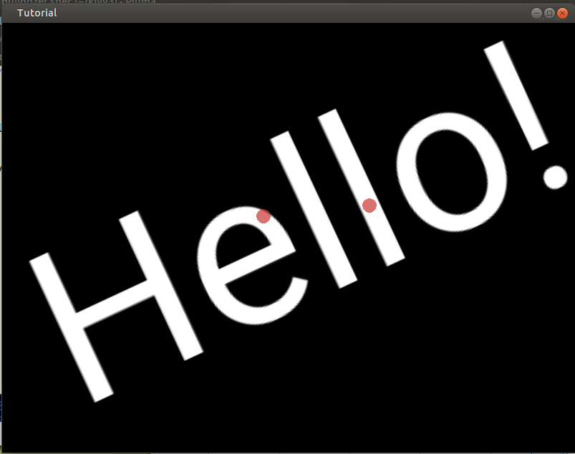
Tutorial – Label. Move Rotate Scaling
from kivy.app import App
from kivy.uix.label import Label
from kivy.uix.scatter import Scatter
from kivy.uix.floatlayout import FloatLayout
class TutorialApp(App):
def build(self):
f = FloatLayout()
s = Scatter()
l = Label(text='Hello!',
font_size=150)
f.add_widget(s)
s.add_widget(l)
return f
if __name__ == "__main__":
TutorialApp().run()

Slide 11
Kivy – Multitouch simulation
On Linux Desktop with traditional monitor there is no Multi-touch.
Right-click to simulate where your fingers touch the screen, then use mouse to perform moving, rotating and scaling.
If developing on a laptop then it may have a multi-touch pad that allows simulation of using you fingers on an Android screen.

Slide 12
Buildozer Features
Change directory to the development folder with main.py file
Initialize and provide the buildozer.spec
Build an Andriod application package in bin/ folder
Deploy the package to an Andriod phone
Provide logcat application for debugging

Slide 13
Buildozer
$ buildozer init Creates buildozer.spec file.
Edit buildozer.spec at three places:
# (str) Title of your application
title = Hello 3
# (str) Package name
package.name = tutorial_3
# (str) Supported orientation (one of
# landscape, sensorLandscape, portrait or all)
orientation = all

Slide 14
Mobile Phone Settings
Samsung Galaxy J5: example
Settings --> About phone --> Software Information --> Build Number x 7 taps.
Settings now has Developer options
Settings --> Developer options --> Unlock OEM to on
Settings --> Biometrics and security -> Install unknown apps --> My Files --> Allow from this source to on
Settings --> Developer options --> Select USB Configuration --> MTP (Media Transfer Protocol)
Know the ARM architecture 7 or 8, and which architecture is Android OS compiled for?

Slide 15
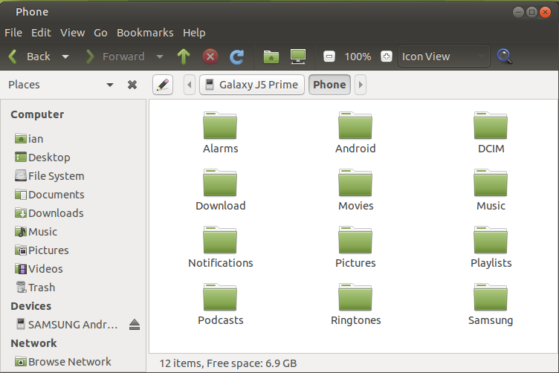
Mobile Phone
Plug Android phone into USB port on development Linux PC. Phone has pop up message:
Allow access to phone data
...click allow
On the PC the File Manager should now see the mobile phones folder:

Slide 16
Kivy – Buildozer – Development Steps
Plug phone into a USB port on the Linux PC.
Create an application development folder. $ cd to it
Write a python GUI application using kivy and name it main.py
Test the app on Linux desktop. $ python3 main.py
$ buildozer init – creates buildozer.spec file
Edit buildozer.spec file
$ buildozer android debug deploy. This builds the Andriod application package and deploys it to the phone. Takes 30 mins? A copy of the app is in the bin/ folder
Click on app on the phone to launch it.

Slide 17
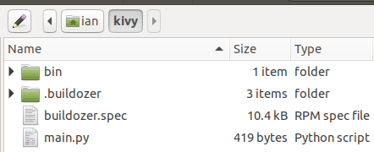
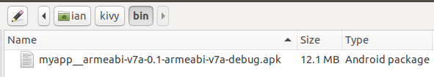
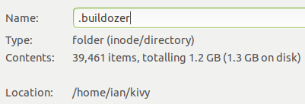
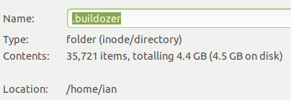
Kivy – Buildozer – Files Review

Slide 18
Kivy – Buildozer - Dependencies
$ sudo apt install openjdk-8-jdk
$ sudo apt install python3-kivy
$ sudo pip3 install buildozer
$ sudo apt install python3-dev
$ sudo apt install cython3
$ sudo apt install cython
$ sudo apt install python3-pip
$ sudo apt install git
$ sudo apt install automake
$ sudo apt install autoconf
$ sudo apt install libltdl-dev
$ sudo apt install libffi-dev
$ sudo apt install lld
$ sudo apt install kivy-examples

Slide 19
Buildozer – Error or Feature?
Initial actions on a folder with your main.py code are:
$ buildozer init
Edit buildozer.spec file
$ buildozer android debug deploy <-- 30+ minutes.
Make changes to main.py
$ buildozer android debug deploy <-- 1 minute. OK
In bulldozer.spec file change package.name
package.name = hello_3 to package.name = hello_4
$ buildozer android debug deploy <-- 5 minutes. Huh?
App fails on loading with libpythonXXX.so missing.
Can change title OK. E.g. title = Hello 4

Slide 20
Demos
From the tutorials demo the code running on Linux and on Android.
Demo a buildozer init. Look at the buildozer.spec file.
Show the libpythonXXX.so error on Android.
Using a .kv file working on Linux but not on Android.
Show bouncing boxes with inline build instead of .kv file
With the scrolling label code, change main.py to alter font size then buildozer android debug deploy. Takes about 1 minute.
Using python os module to collect information on Android.
Show Linux File Managers perspective of folders on Phone

Slide 21
Any Questions?

Slide 22
Appendix - Notes

Slide 23
Jargon – Todo add more...
P4a - Python for Android
NDK – Native development Kit. A set of tools tha allows you to use C and c++ code with Android.
SDL - Simple DirectMedia Layer is a crossplatform development library designed to provide low level access to audio, keyboard, mouse, joystick and graphics via OpenGL and Direct3D.

Slide 24
Kivy - Sister projects:
Buildozer: generic Python packager for Android and iOS.
Plyer: platform-independent Python wrapper for platform-dependent APIs.
Pyjnius: dynamic access to the Java/Android API from Python.
Pyobjus: dynamic access to the Objective-C/iOS API from Python.
Python for Android: toolchain for building and packaging Python applications for Android.
Kivy iOS: toolchain for building and packaging Kivy applications for iOS.
Audiostream: library for direct access to the microphone and speaker.
Kivy Designer: UI designer for Kivy.
KivEnt: entity-based game engine for Kivy.
Garden: widgets and libraries created and maintained by users.
kivy-sdk-packager: Scripts for Kivy SDK generation on Windows, macOS and Linux.
kivy-remote-shell: Remote SSH+Python interactive shell application.
KivyPie: Raspbian-based distribution running latest Kivy framework on the Raspberry Pi.
OSCPy: a fast and reliable OSC implementation.

